Slide 1
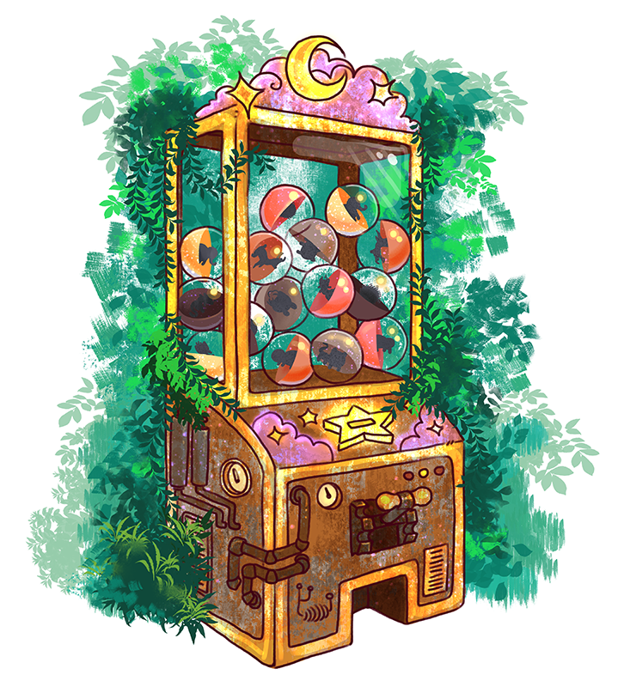
Gacha Collection Beckend
290AA – Advanced Software Engineering
Group: Ardizzoni Francesco Del Castello Diego Prestifilippo Colombrino Mattia Tortorelli Felice

Slide 2

User
ID
First Name
Last Name
E-mail
Password (hash)
History
Currency Amount

Slide 3













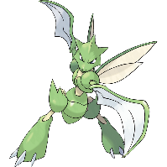



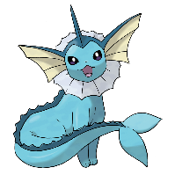

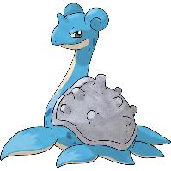



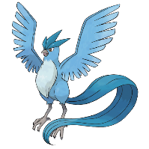

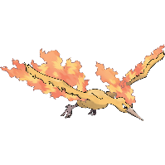
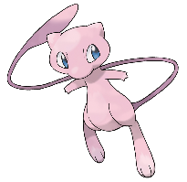

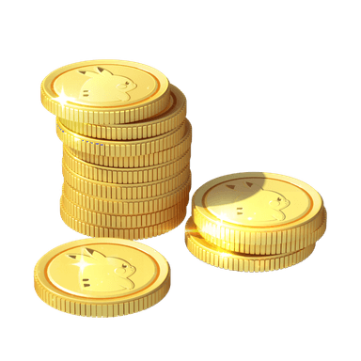

Catalogue – All 151 Pokémon from 1° gen
Common (54,45%)
Uncommon (40%)
Rare (5%)
Epic (0,5%)
Legendary (0,05%)
In-game currency: Pokedollars

Slide 4
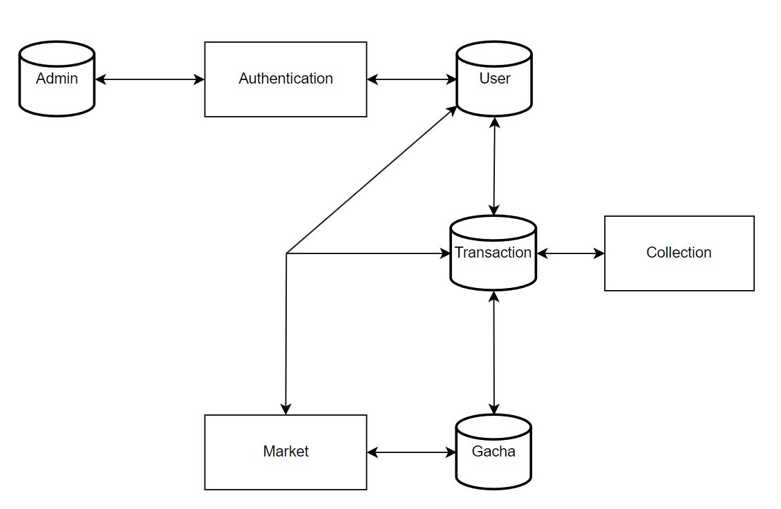
The Architecture

Slide 5
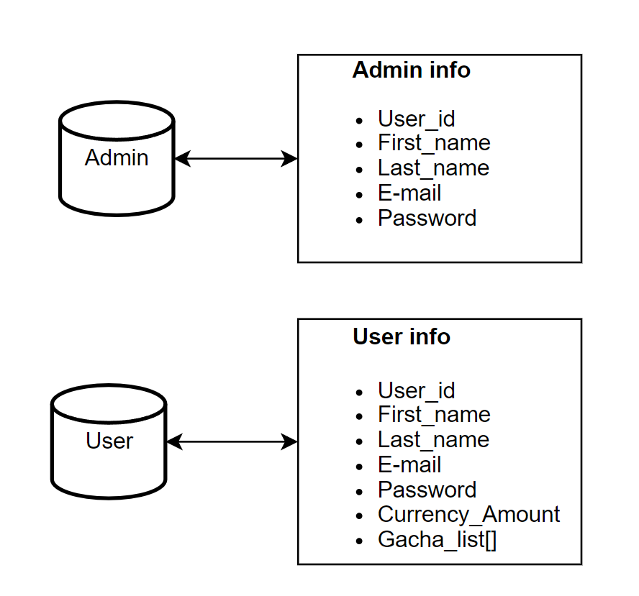
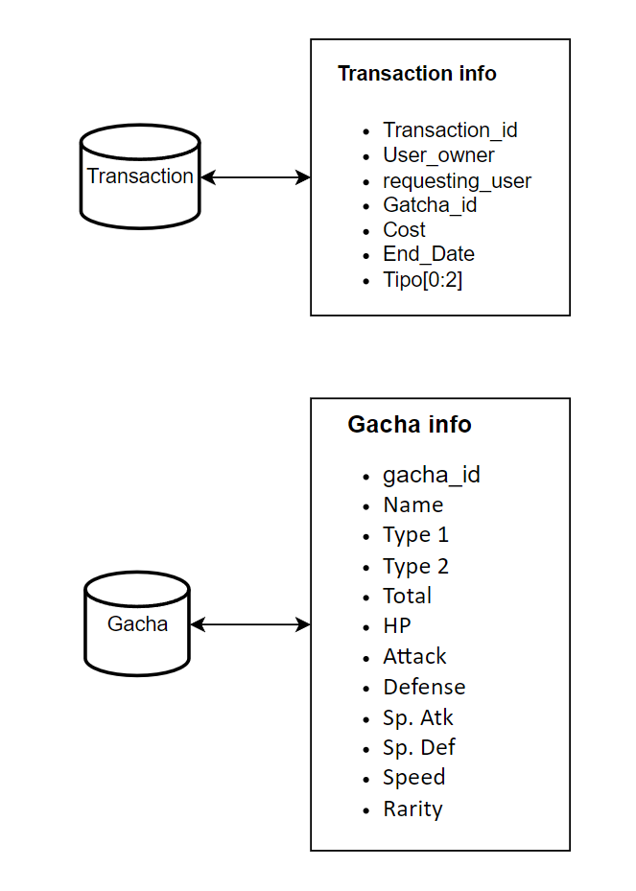
The Architecture

Slide 6
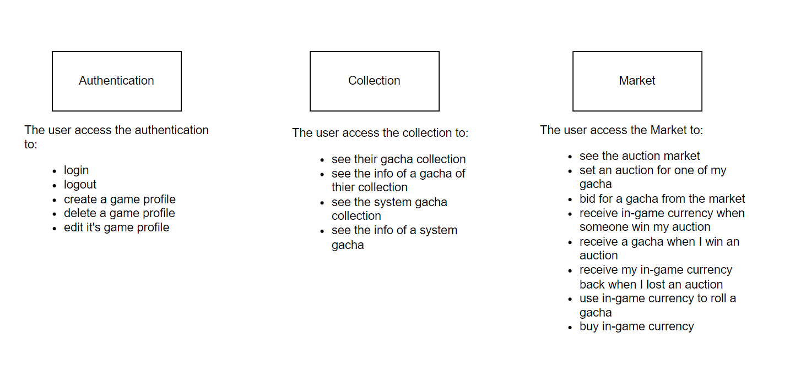
The Architecture

Slide 7
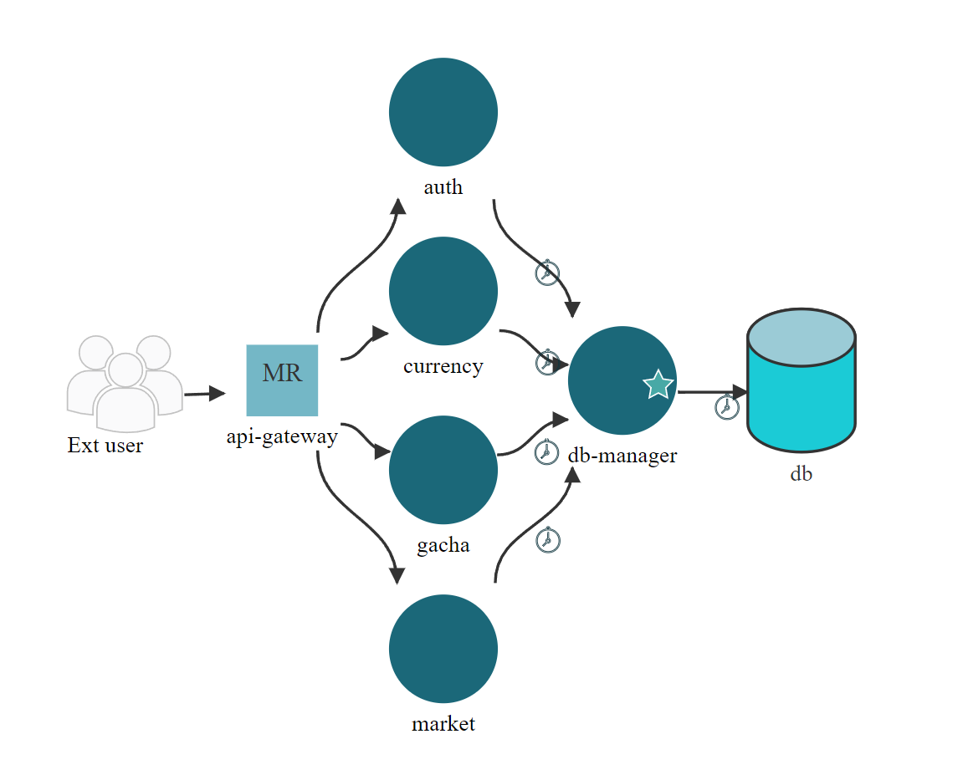
Microfreshener

Slide 8
The micro-services
-api-gateway This API Gateway acts as the main entry point for client requests, forwarding them to the appropriate microservices for processing. It integrates with multiple services.
-db-manager
This API is part of a microservices architecture and handles all the queries to the database.
-auth-service This API is part of a microservices architecture and serves as the user management service for the application. It provides operations such as register a new user or authenticate a user
-currency-service
This API is part of a microservices architecture and serves as the currency management service for the application. It provides operations for managing in-game currency and rolling gacha items.
-gacha-service
This API is part of a microservices architecture and serves as the gacha management service for the application. It provides operations for managing gachas and retrieving gacha infos.
-market-service
This API is part of a microservices architecture and handles transactions related to gacha itemsand user purchases. It interacts with other services to track and update user transactions.

Slide 9
The register service datapath
The registration-related services are exposed externally to clients on port 8000 via an API gateway. When an HTTPS request is received for user registration, the API gateway forwards the HTTPS request to the auth-service/register on port 8001.
The auth-service itself exposes APIs on port 8001 to handle user registration, login, updating user details, and deleting users. To interface with the database, the auth-service sends an HTTPS request to the db_manager, which provides APIs for database-related operations. These database-related APIs are exposed by the db_manager on port 8005.
Once the registration is successful, without any problems on DB, the db-manager service communicates the registration in the database. The auth-service service will then forward the response obtained to the api-gateway

Slide 10
The login service datapath
The login_user-related services are exposed externally to clients on port 8000 via an API gateway. When an HTTPS request is received for user registration, the API gateway forwards the HTTPS request to the auth-service/login_user on port 8001.
The auth-service itself exposes APIs on port 8001 to handle user login. To interface with the database, auth-service sends an HTTPS request to the db_manager( containing the user's email), which provides APIs for database-related operations. These database-related APIs are exposed by the db_manager on port 8005.
The db-manager performs a lookup through the email provided and returns the corresponding encrypted password if successful. The auth.service service will then perform a check on the password now encrypted by the user and the one received from the db-manager. If the match is positive, the auth-service service will then forward the login to the api-gateway.

Slide 11
The gacha service datapath
The currency service is exposed to external clients through an API Gateway on port 8000.
When an HTTPS request for roll_gacha or buy_currency is received, the API Gateway forwards the request to the currency_service via HTTPS on port 8004. The currency_service is responsible for implementing the business logic associated with these requests.
To interface with the database, the currency_service sends an HTTPS request to the db_manager, which listens on port 8005. The db_manager exposes APIs that handle database queries, enabling the currency_service to retrieve or update data as required.

Slide 12
The currency service datapath
The gacha-related services are exposed externally to clients on port 8000 via an API gateway. When an HTTPS request is received for a service related to CRUD operations for gacha, the API gateway forwards the HTTPS request to the gachaservice on port 8002.
The gachaservice itself exposes APIs on port 8002 to add, modify, delete, and view a single gacha or the entire collection of gachas.
To interface with the database, the gachaservice sends an HTTPS request to the db_manager, which provides APIs for database interfacing services. These database-related APIs are exposed by the db_manager on port 8005.

Slide 13
The gacha service datapath
The currency service is exposed to external clients through an API Gateway on port 8000.
When an HTTPS request for roll_gacha or buy_currency is received, the API Gateway forwards the request to the currency_service via HTTPS on port 8004. The currency_service is responsible for implementing the business logic associated with these requests.
To interface with the database, the currency_service sends an HTTP request to the db_manager, which listens on port 8005. The db_manager exposes APIs that handle database queries, enabling the currency_service to retrieve or update data as required.

